Slide 1
School Safety Committee

Slide 2
Emergency Drills
Earthquake: Drop, Cover and Hold (Evacuation only if announced)
Fire: Calmly evacuate to back field. Stay with your teacher at all times.
Reverse Lockdown: Go to the nearest classroom. Prepare for Shelter In Place Red. No one in; No one out. Cell Phones should be turned off and submitted to your teacher. Stay calm. Be quiet!

Slide 3
Shelter in Place: RED
Threat is on-campus
Lock doors
NO ONE IN; NO ONE OUT
Cover Windows
Shut off lights
SECURE Cell Phone
Sit on Floor along wall away from doors & windows
Remain silent
Drill is announced; Real Situation- GPD or admin will unlock your door

Slide 4
Shelter in Place: YELLOW
Business as usual – maintain classroom instruction
Do NOT lock doors or shut off lights
NO ONE IN, NO ONE OUT
Look in your classroom for any suspicious objects.
Take attendance
Place green/red door tag
STRICTLY NO USE OF CELL PHONE OR RADIO
Evacuate only if instructed. (Possibly by wings or sections.)

Slide 5
Evacuation Procedures
Teachers escort students to the designated area (Students don’t leave your teacher behind.)
Electives and students report to the Teacher’s assigned team
Display evacuation flags (red/green) properly. Students must hold it correctly.
Students stay in assigned area
Teachers take attendance.
Teachers fill out form
Aides will collect forms from teachers.

Slide 6
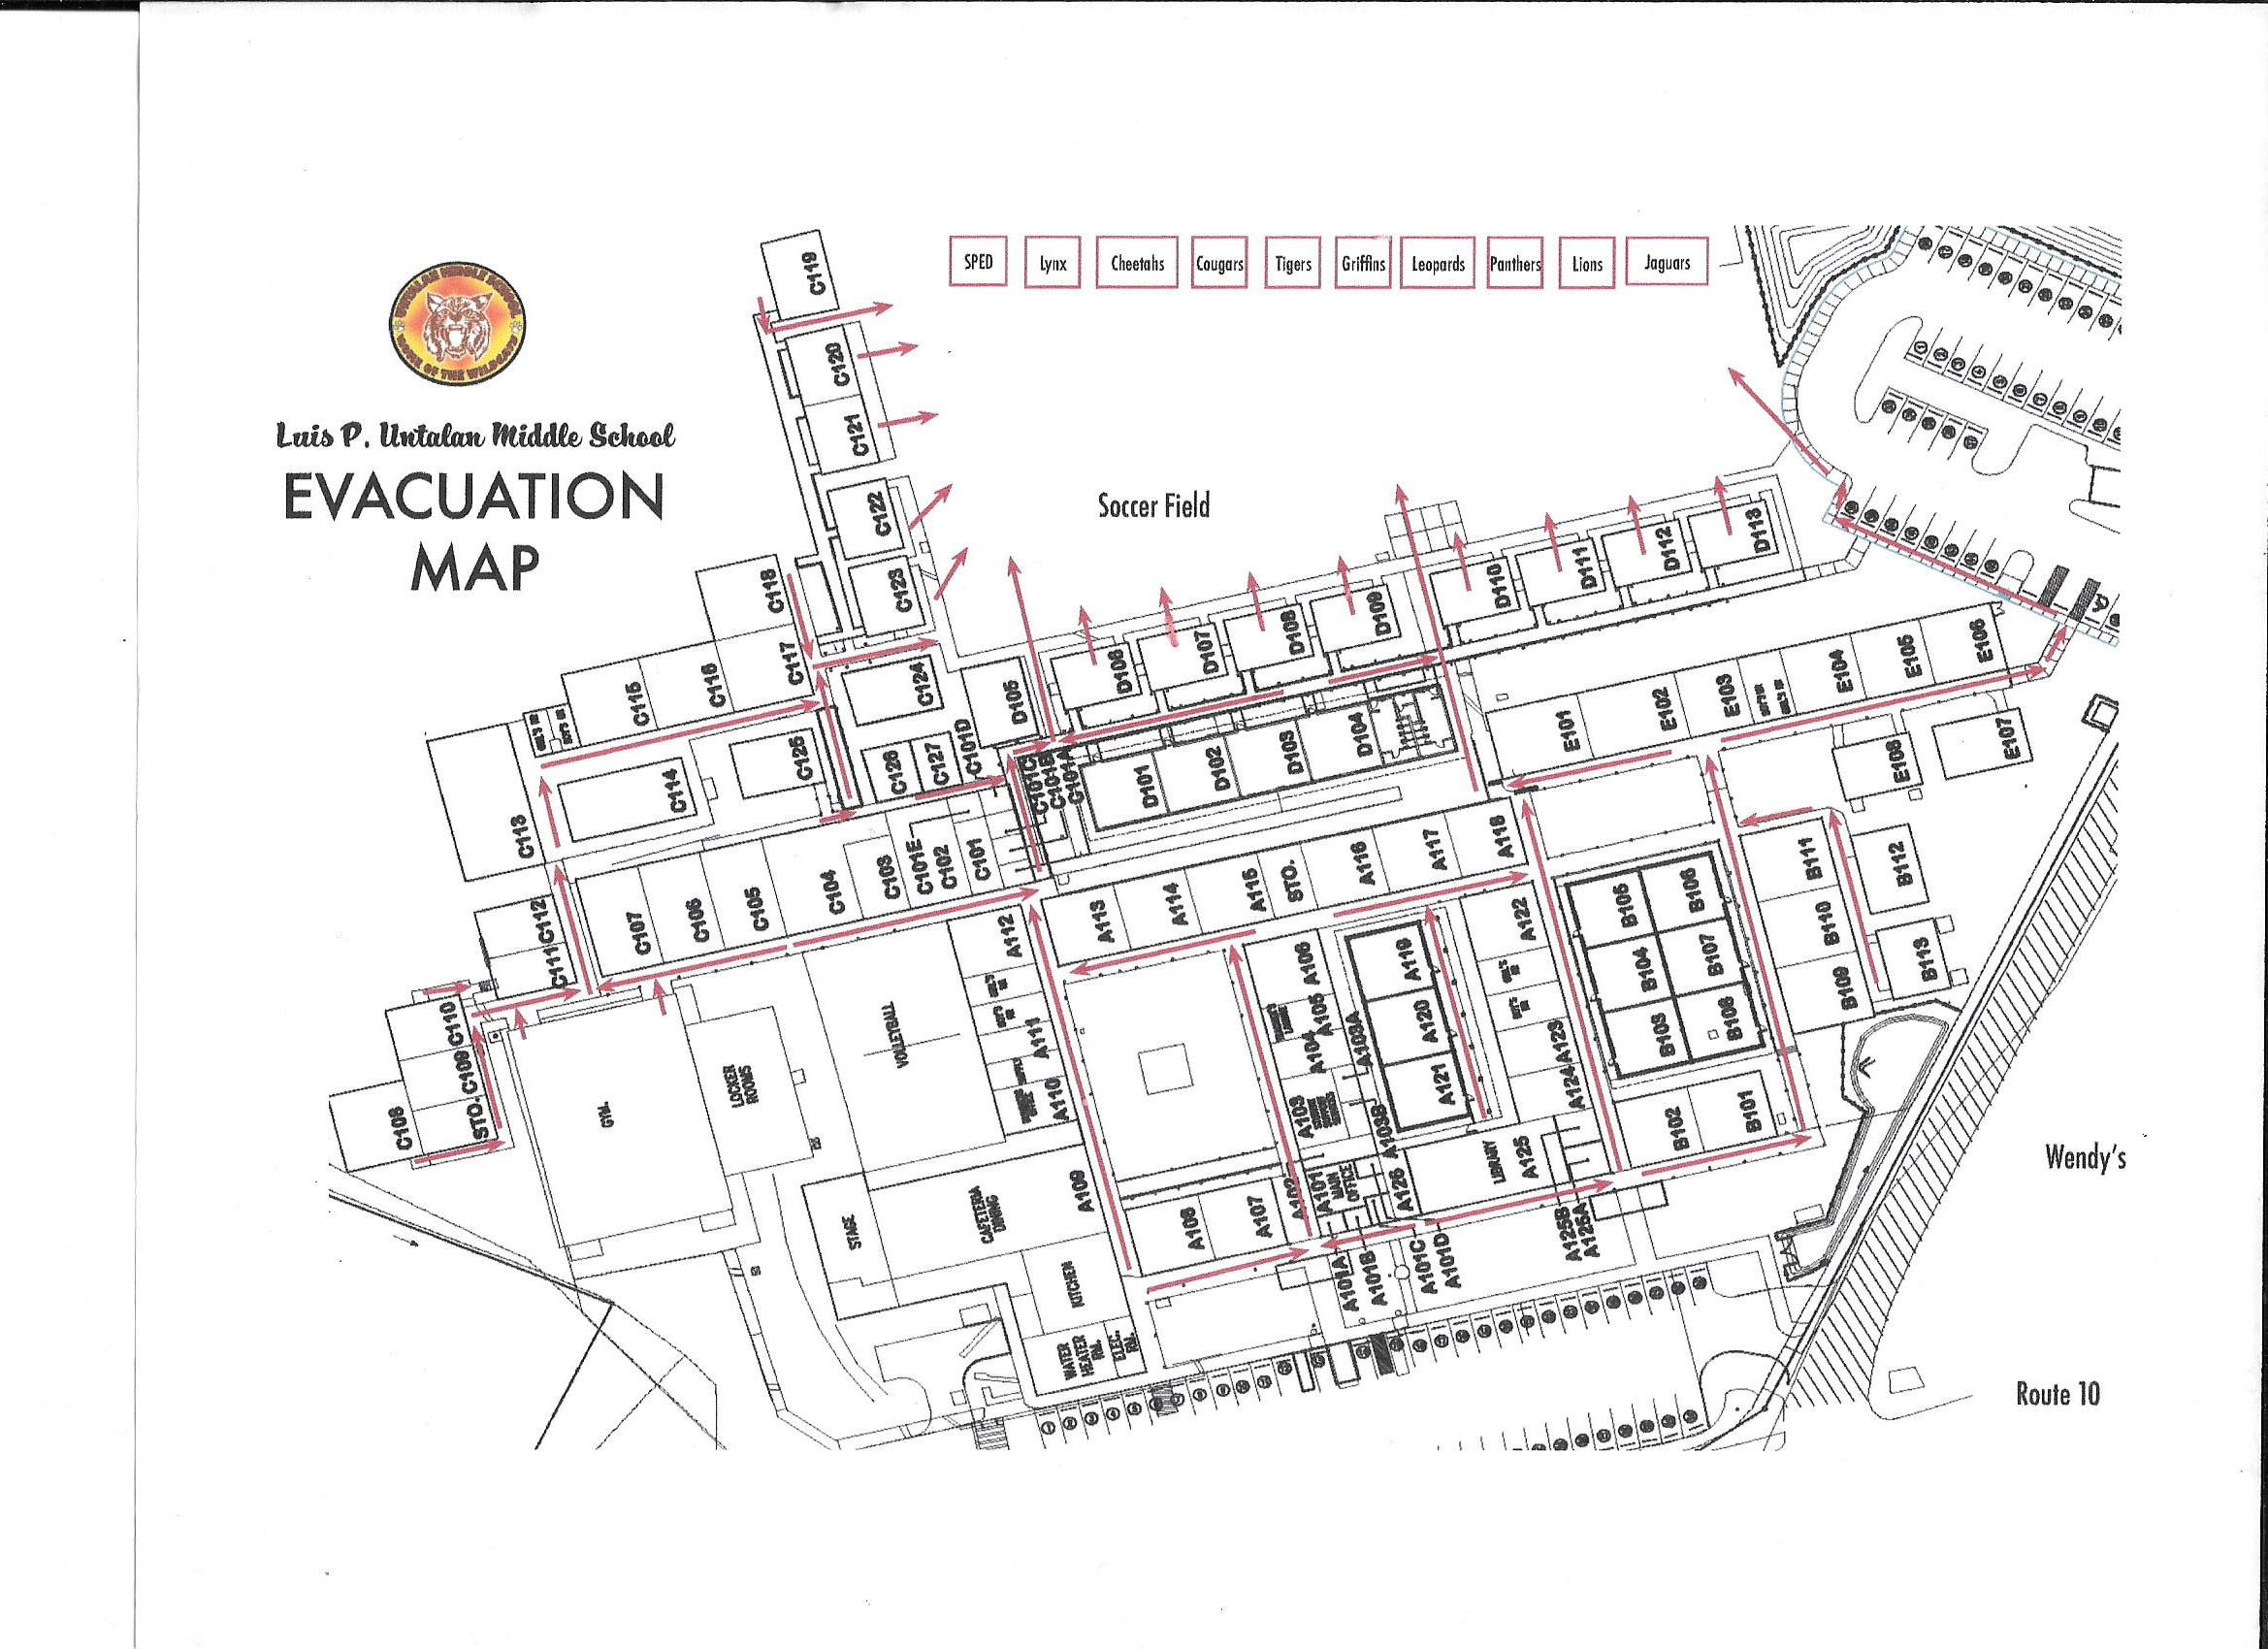

Slide 7
Review Quiz
School Safety Committee

Slide 8
What is the password after a lockdown?
A. The Wild Cat is purrrrrrring
B. Code Green
C. All Clear
D. Are you kidding me? We’ve only been told there is no password a million times. (exaggeration)

Slide 9
What is the difference between Code Yellow & Code Red
A. They make Orange
B. Red taste better
C. The difference is 5
Code Red is to be treated as Lockdown with the threat on campus, while Code Yellow is business as usual after the teachers has looked for suspicious items and taken attendance of their class

Slide 10
During an evacuation, where should you always be?
A. Somewhere over the rainbow
B. At home
C. Wherever the snacks are
D. With my teacher

Slide 11
Questions?

